Slide 1
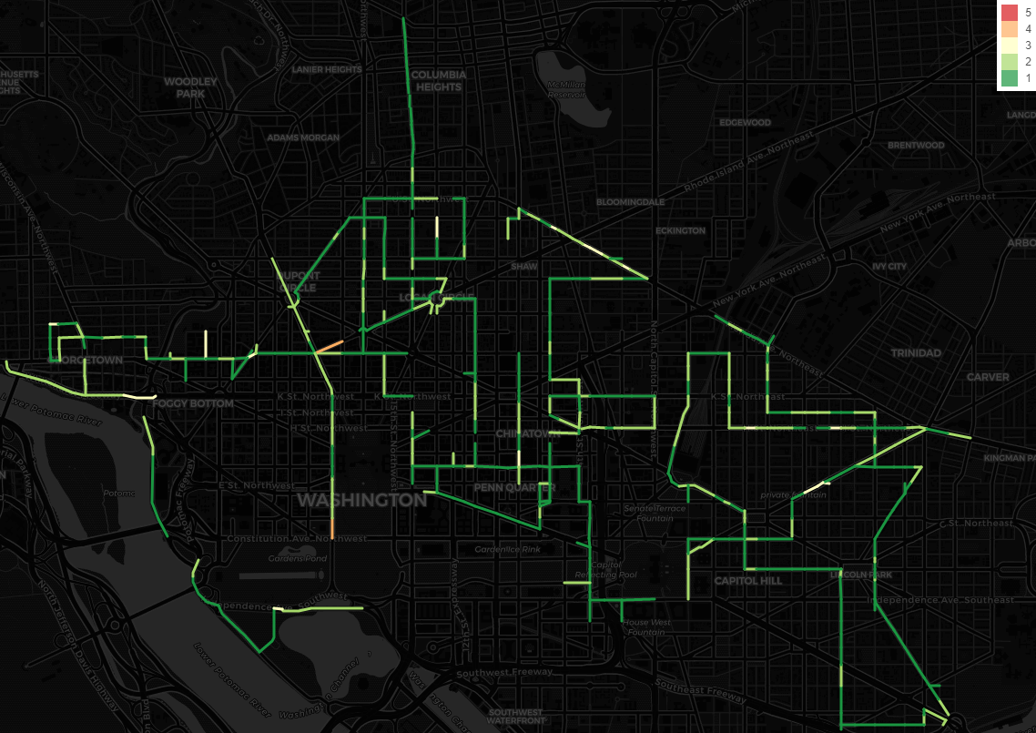
diff=4
diff=3
diff=2
diff=1
diff=0

Slide 2
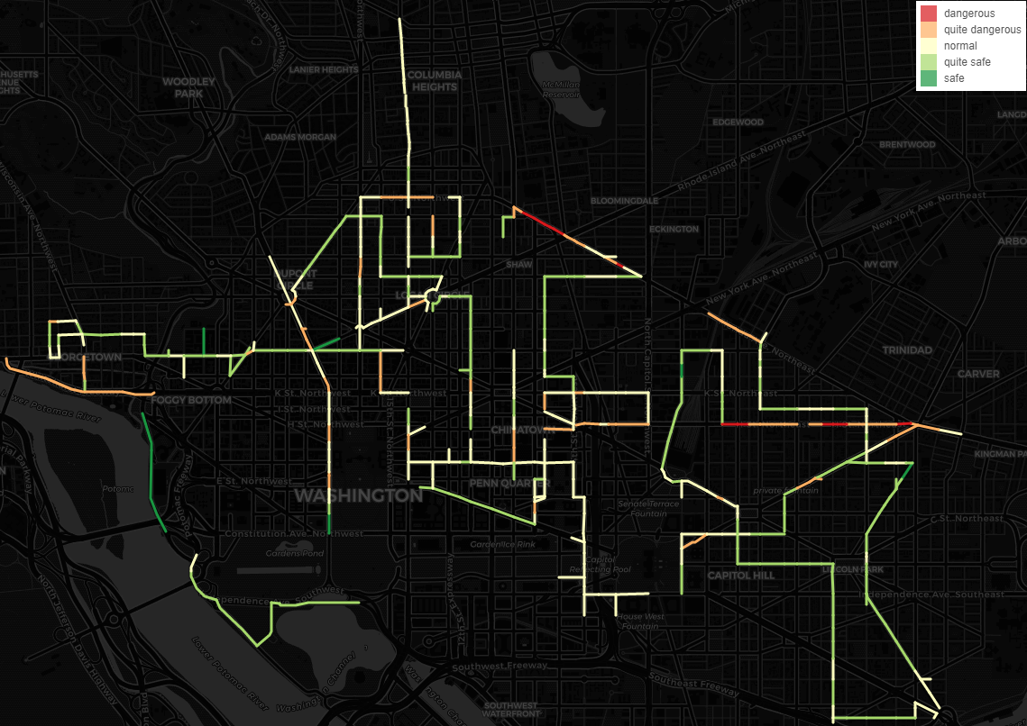
very dangerous
dangerous
normal
safe
very safe

Slide 3
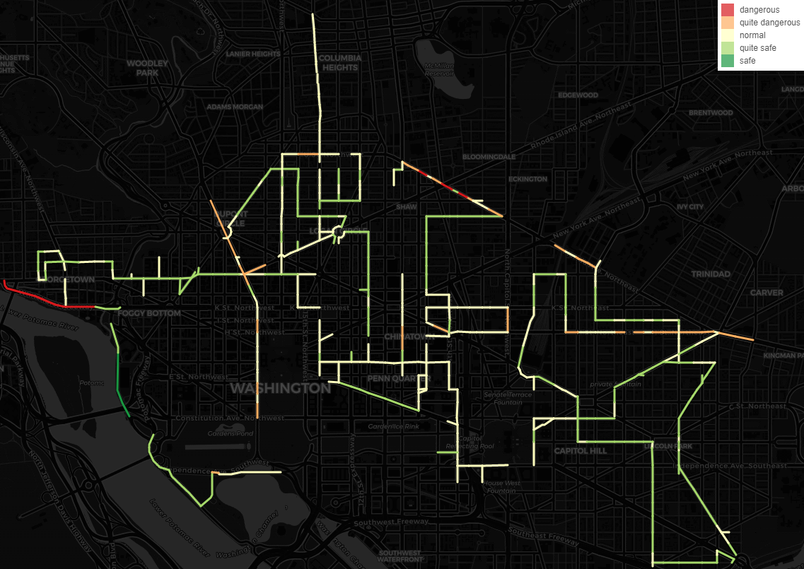
very dangerous
dangerous
normal
safe
very safe

Slide 4
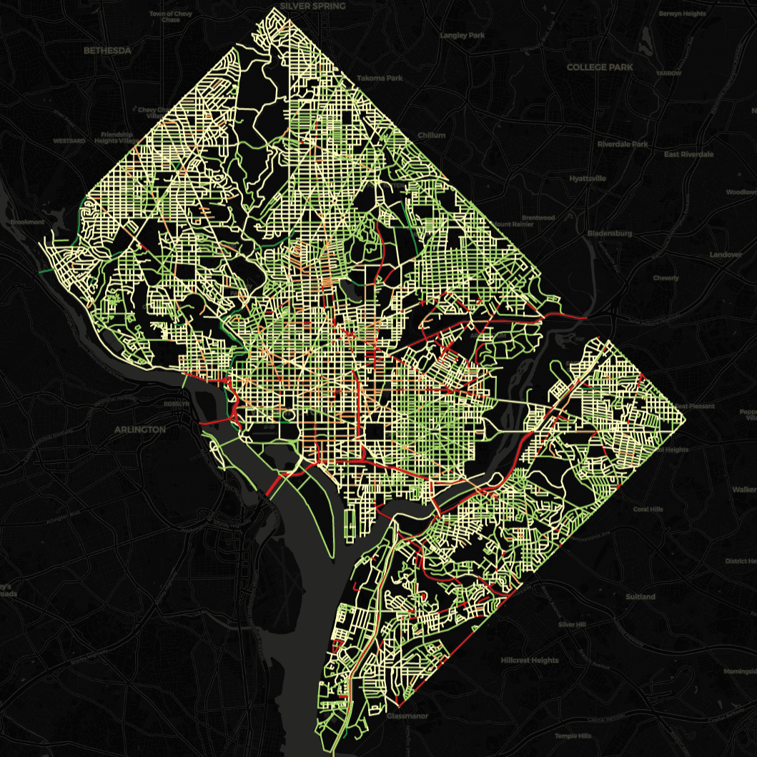
very dangerous
dangerous
normal
safe
very safe

